Slide 1
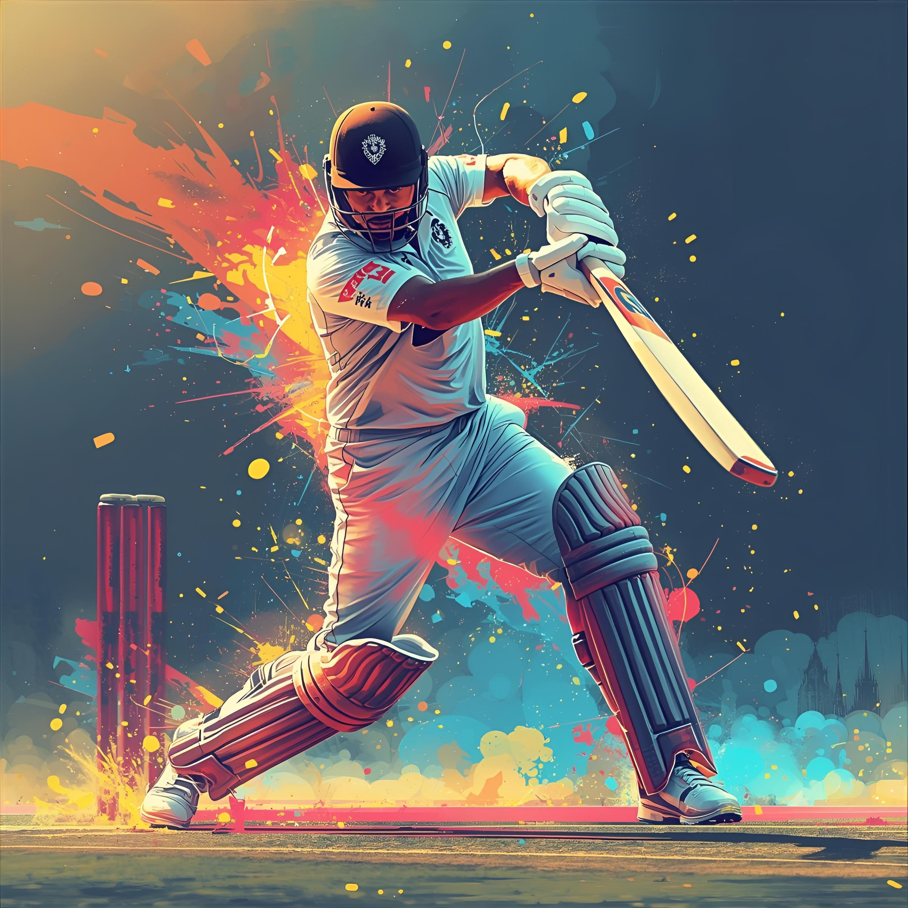

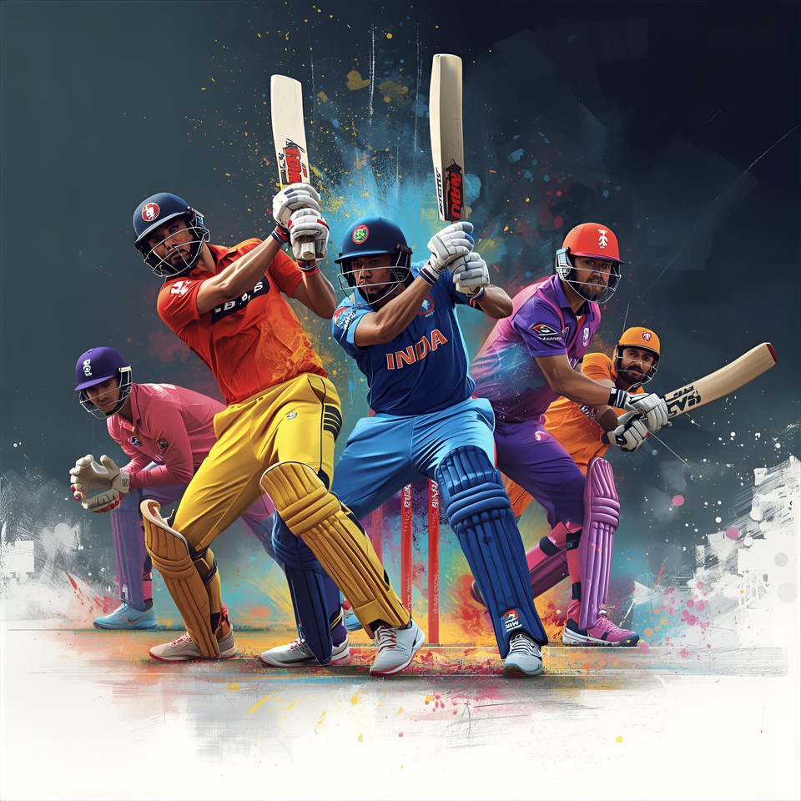
Batting Drills
Raju Keshetty
ICC Certified Coach

Slide 2
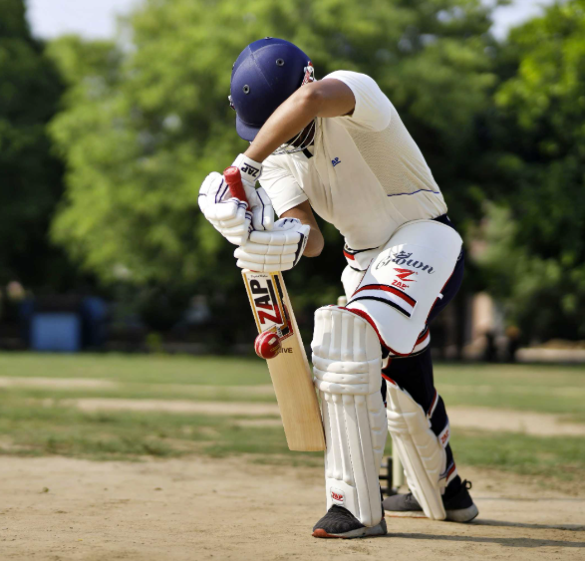
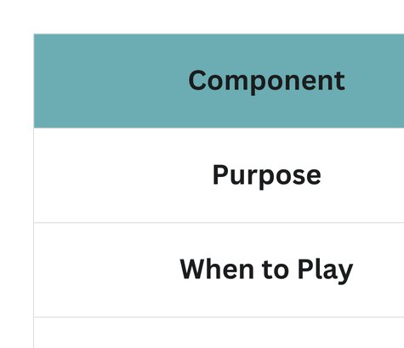
Forward Defense
(The Wall)
Raju Keshetty
ICC Certified Coach

Slide 3
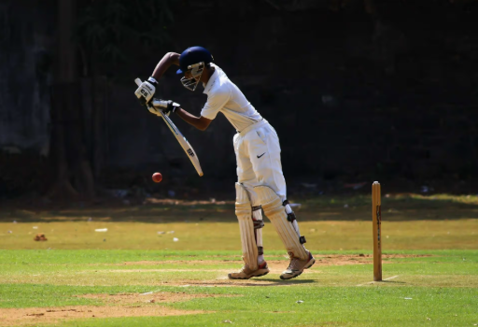
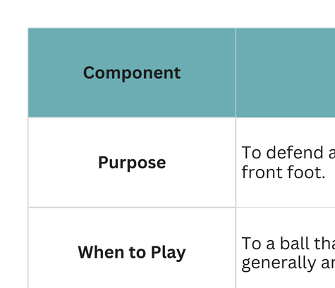
Back-Foot Defense
Raju Keshetty
ICC Certified Coach

Slide 4
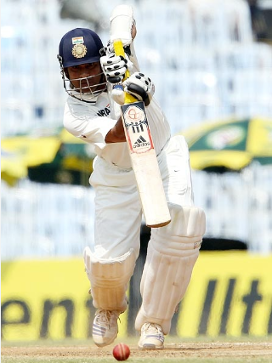
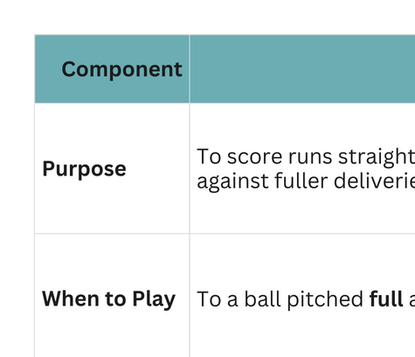
Straight Drive
Raju Keshetty
ICC Certified Coach

Slide 5
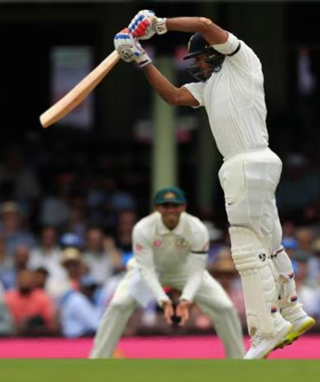
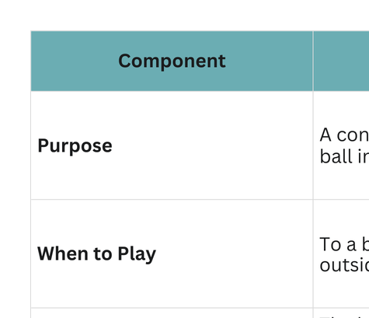
Back-Foot Punch
Raju Keshetty
ICC Certified Coach

Slide 6
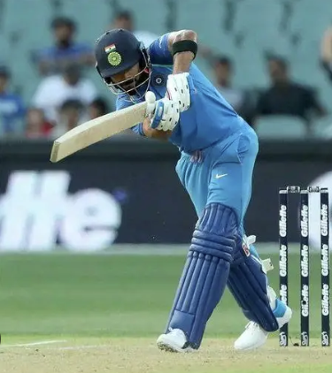
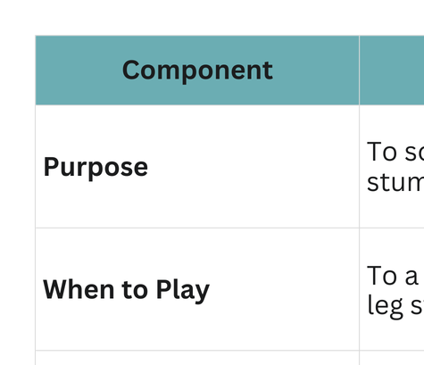
Leg Glance / Flick
Raju Keshetty
ICC Certified Coach

Slide 7
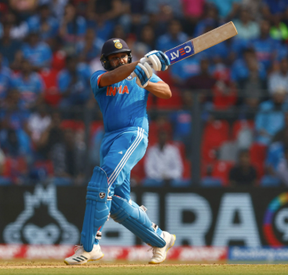
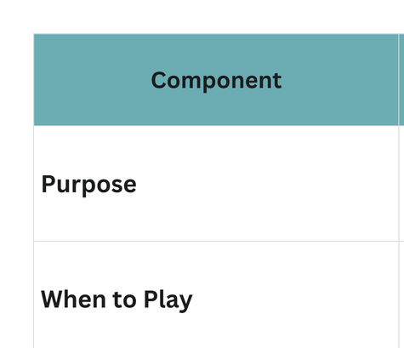
Pull Shot
Raju Keshetty
ICC Certified Coach

Slide 8
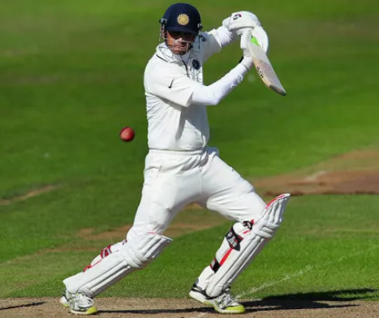
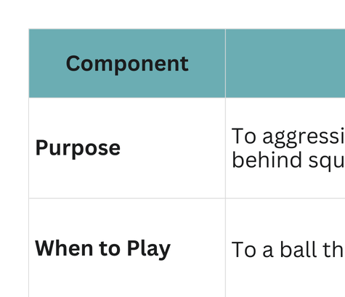
Cut Shot
Raju Keshetty
ICC Certified Coach

Slide 9
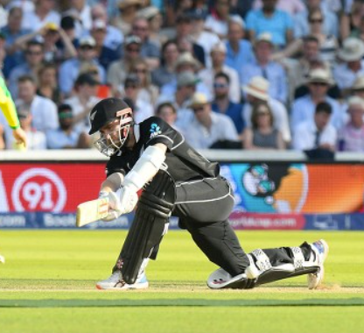
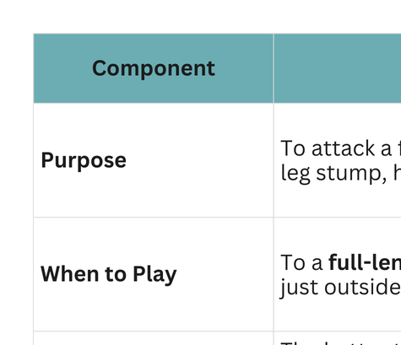
Sweep Shot
Raju Keshetty
ICC Certified Coach

Slide 10
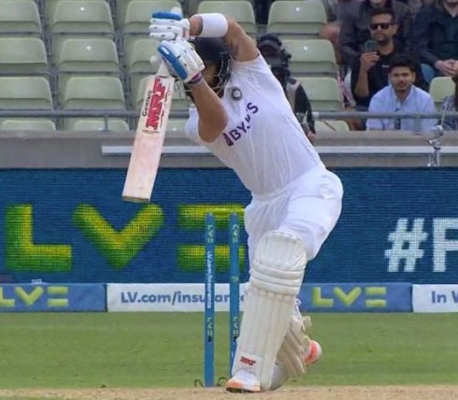
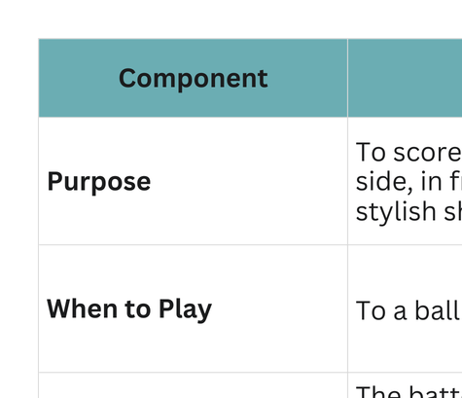
Off-Drive
Raju Keshetty
ICC Certified Coach

Slide 11
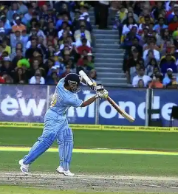
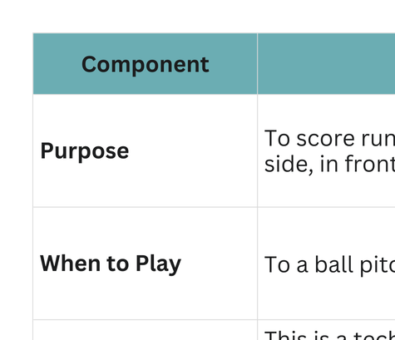
On-Drive
Raju Keshetty
ICC Certified Coach

Slide 12
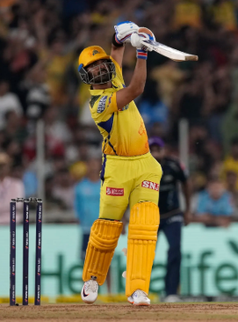
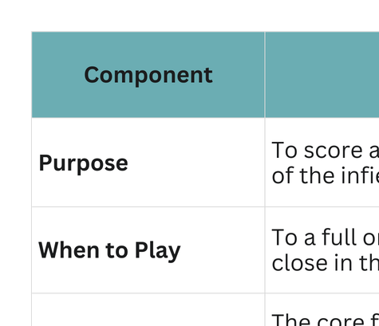
Lofted Straight Drive
Raju Keshetty
ICC Certified Coach

Slide 13
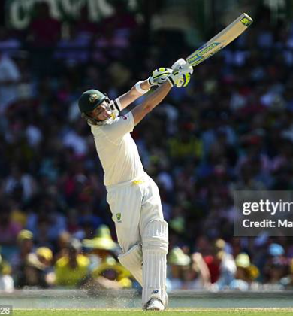
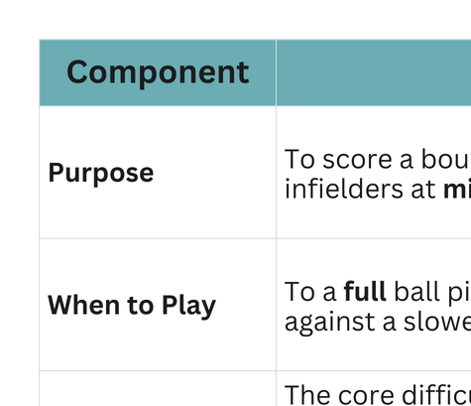
Lofted On-Drive
Raju Keshetty
ICC Certified Coach

Slide 14
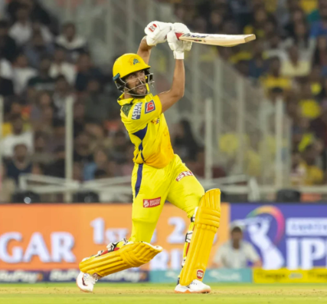
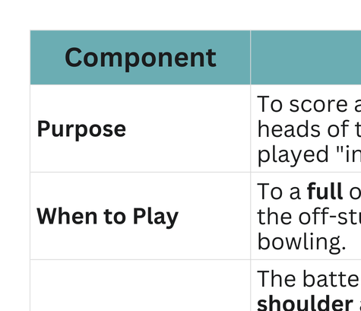
Lofted Cover Drive
Raju Keshetty
ICC Certified Coach

